Slide 1
Clustering Netflix data
Presented by: Erica Quintana

Slide 2
Table of Contents
The Data
The Business Question
The Practical Uses of Results
Methods and Data Exploration
Analysis
Results
Shortcomings of Analysis

Slide 3
The Data
Netflix data from 2021
Obtained from:
https://www.kaggle.com/shivamb/netflix-shows/metadata

Slide 4
The Research Question
How can unsupervised learning techniques be used to identify movies and tv shows that are similar to each other based on characteristics?

Slide 5
The Practical Uses of Results
If able to effectively create clusters of TV shows and Movies based on shared characteristics, the model can be used to recommend content based on user preferences and history.

Slide 6
Data Exploration and Preparation
The dataset initially contained 12 variables and 8807 observations
Data exploration through visualization
Visualization of count of movies by genre type. Filled in missing data with blanks.
Visualization of content by TV Show versus Movies.
Visualization of content by country in Netflix data.
Visualization of content by rating.
Dataset manipulation for analysis
Added unique genres as variables to dataset
Used only the first country listed for content
Created dummy variables for:
Rating
Type of content
Duration
Release year
Ended with dataset of 336 variables and 8807 observations

Slide 7
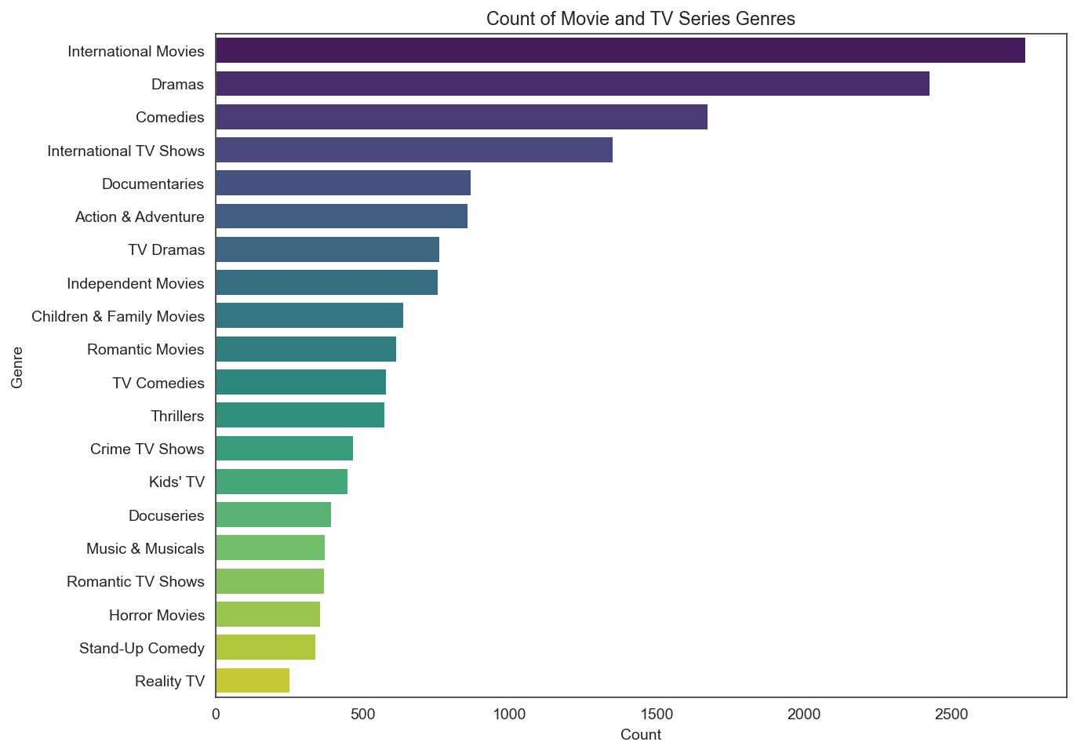
Count of TV shows and Movies by Genre

Slide 8
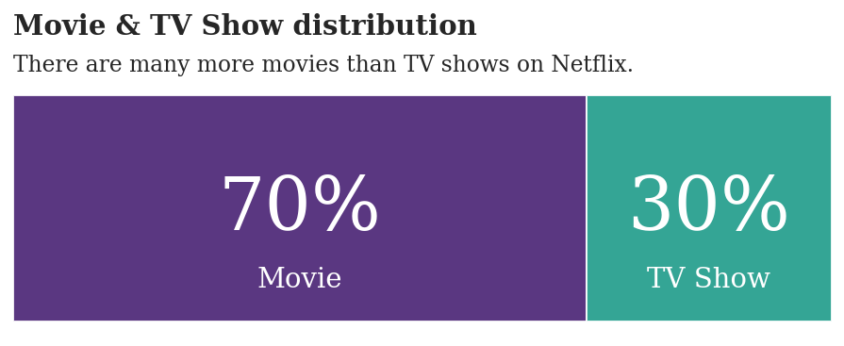
Content of Netflix: TV shows vs Movies

Slide 9
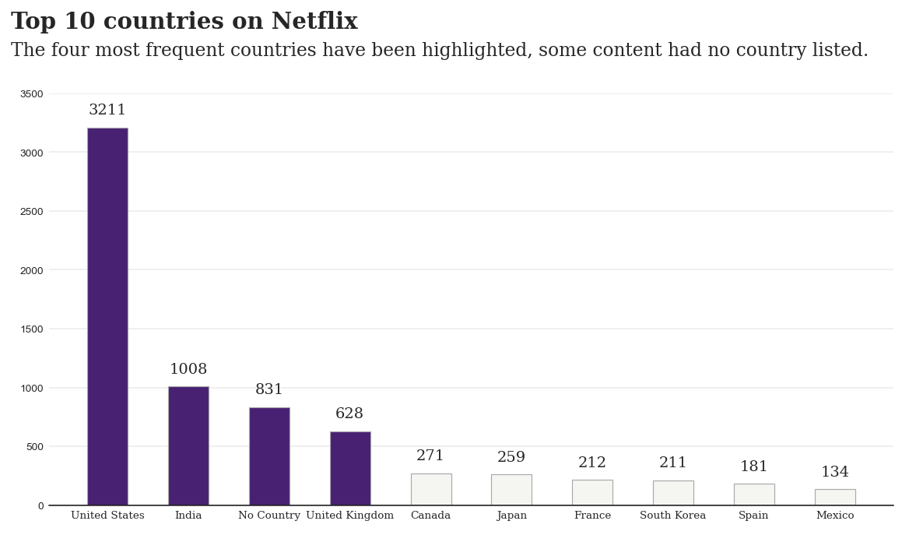
Content of Netflix by Country

Slide 10
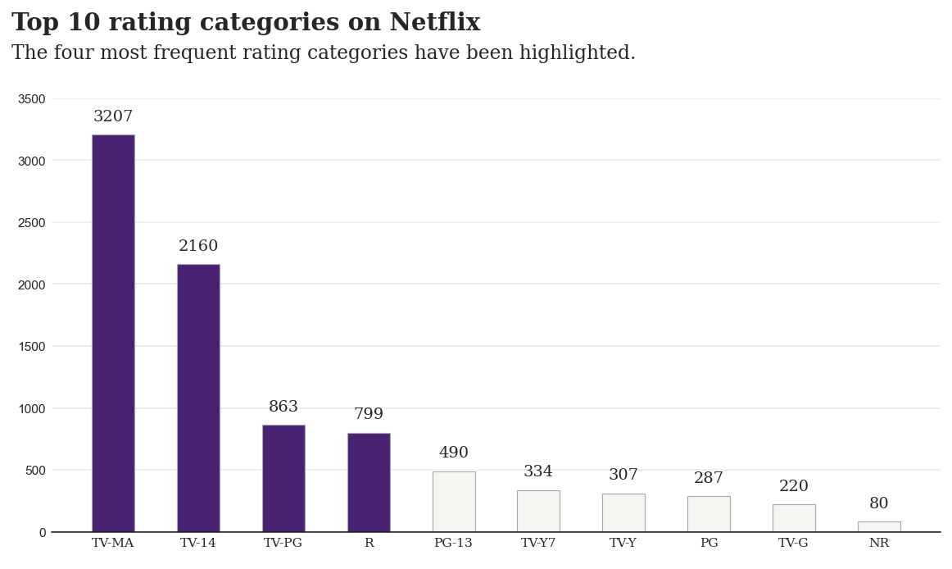
Content by Rating Category

Slide 11
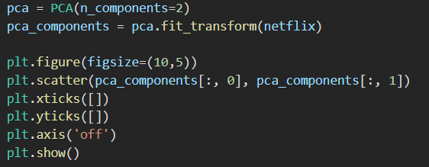
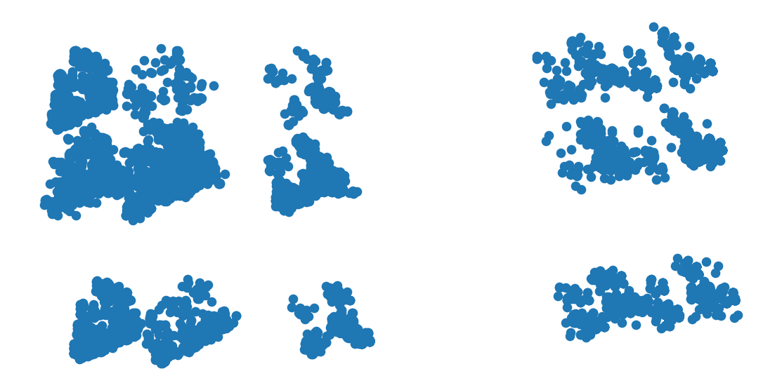
Dimensionality Reduction PCA attempt 1

Slide 12
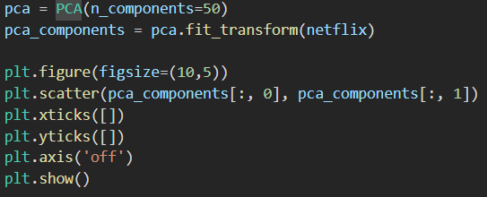

Dimensionality Reduction PCA attempt 2

Slide 13
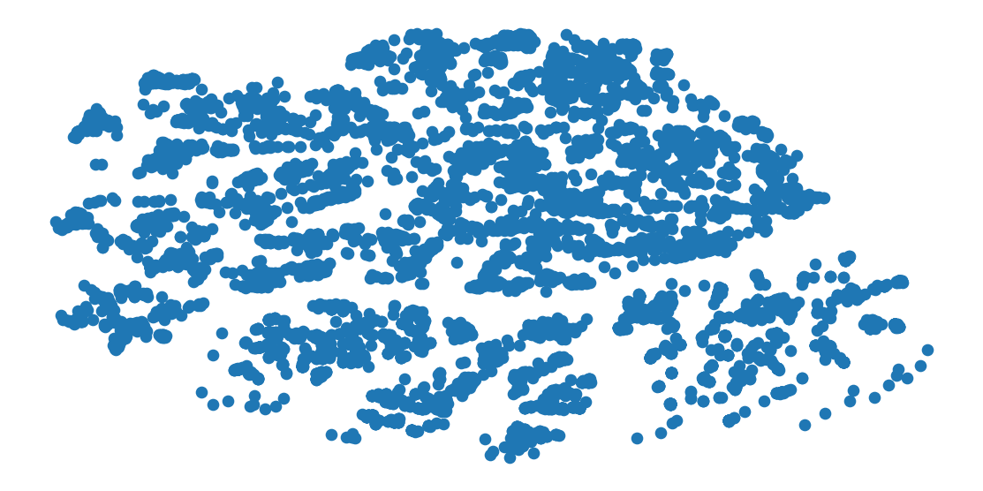
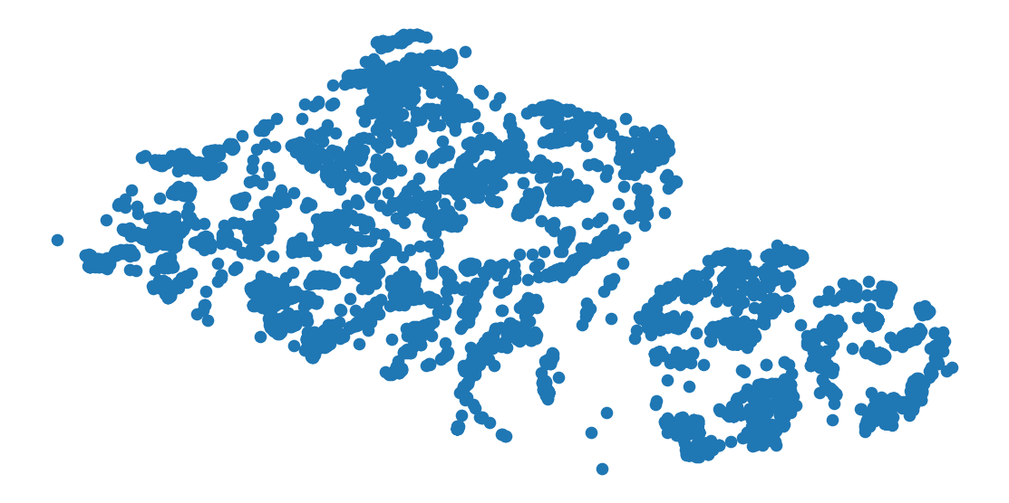
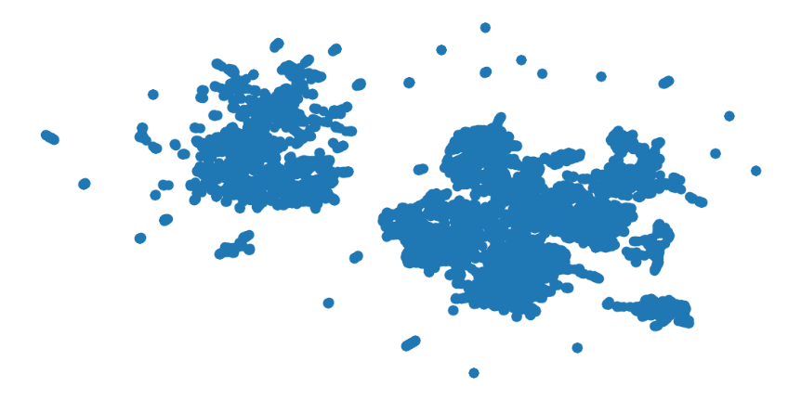
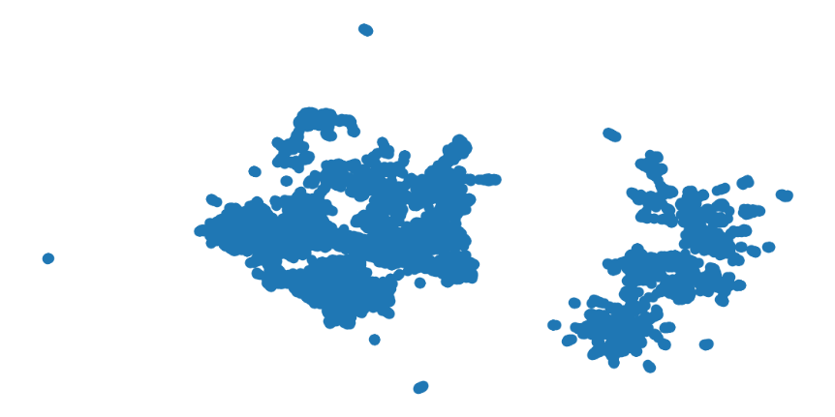
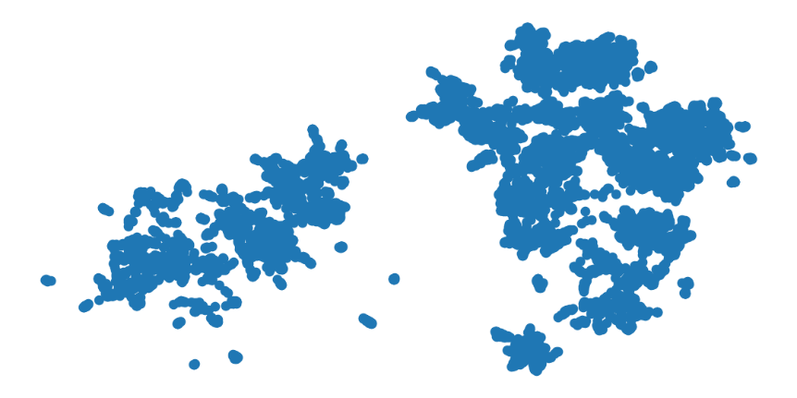

Dimensionality Reduction t-SNE attempts 1-6
1
2
3
4
5
6

Slide 14
Dimensionality reduction choice
Since there is no known correct answer for this particular dataset, I chose to proceed with the PCA attempt 1 since it resulted in fairly clear separation.

Slide 15
Clustering models attempted
K-means
Hierarchical
Gaussian Mixture Model

Slide 16
Clustering model results
K-means with 7 clusters. Silhouette score: 0.6413103844596718
Hierarchical with 7 clusters. Silhouette score: 0.6402313271357205
Gaussian Mixture Model with 8 clusters. Silhouette score: 0.6280399133028505

Slide 17
Recommendations
When using clustering to identify TV shows and Movies based on similar characteristics, I recommend using the PCA dimensionality reduction technique along with K-means clustering with 7 clusters.

Slide 18
Shortcomings of model
There were many dummy variables created to account for different levels of variables in the dataset. It is possible that further reduction of the number of variables by using grouping techniques could potentially help the model perform better.
Combining multiple models over time may help to address the lack of known data or divisions of groups.

Slide 19
Clustering V. Modeling
Clustering pro: allows for unique patterns and groupings to emerge directly from the data without much interference by the analyst.
Clustering con: lack of known truth of dataset (something to compare results to) means we can’t truly know how well the results reflect reality.
Modeling pro: presence of known outcomes allows for model comparison to real-world truth and provides opportunities for model improvement.
Modeling con: does not identify patterns directly from data and analysts may miss unique or important insights.

